Slide 1


PLEDGE RED
Done by:
Chandu(21eg112a12)
Dharanidhar(21eg112a17)
VigneshVardhan(21eg112a20)
Shreenitha(21eg112a39)
Neerupam raj(21eg112a11)

Slide 2
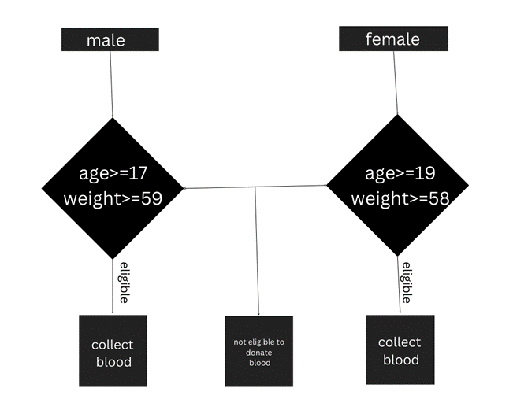

Flow of control
Struct blood_donation
{
Char name[50];
Int age;
Int weight;
Char gender;
Int blood_group;
Int pincode;
Struct blood_donation*link;
};

Slide 3
Abstract
Pledge red using application of linked list.
It is a standalone application.
It provide user friendly service person who need was in need of blood.
It fills the gap between the donar and the person who is in need of blood .
While taking the blood from the donar it takes information about there
age ,weight .gender and blood group of donar.
It also take pincode of donar while he is donating blood so that we can facilitate with no time when the person is in need of blood

Slide 4
System requirements
Hardware requirements:
2GB ram memory.
Intel core i3 processor.
Software requirements:
Window 7 or above operating system.
Mysql server.
Technolongies used:
c language includes basic input output statement, loops(do while), switch case etc.
Data structure concept linked list is used.

Slide 5
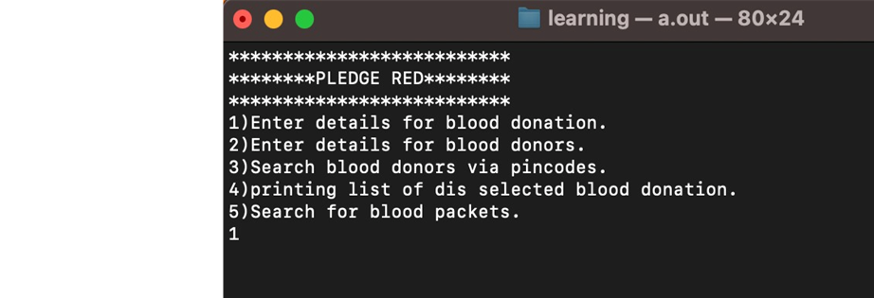
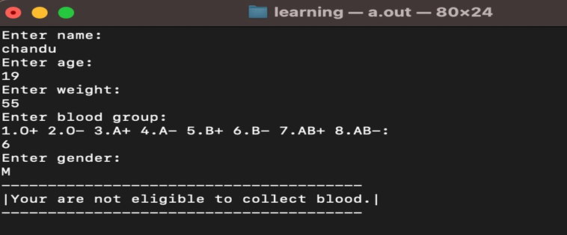
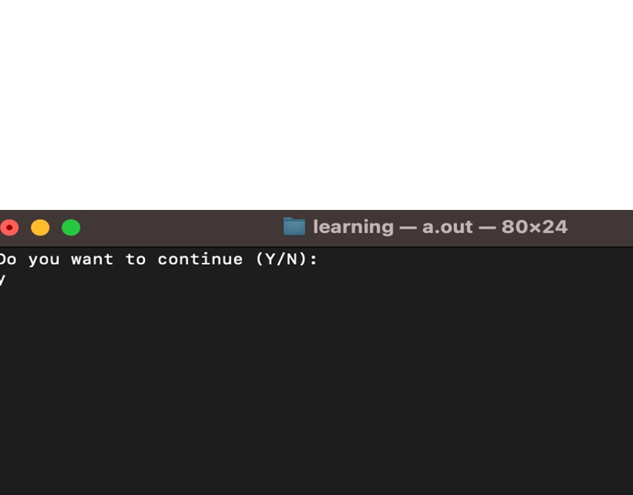
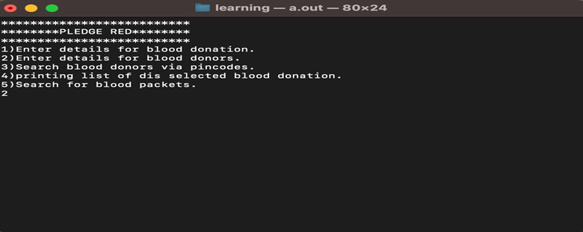
Out put

Slide 6
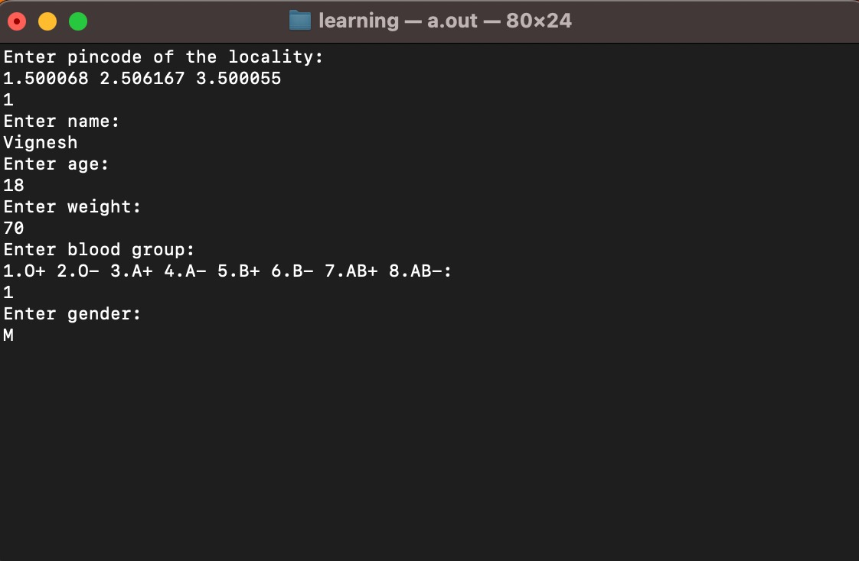
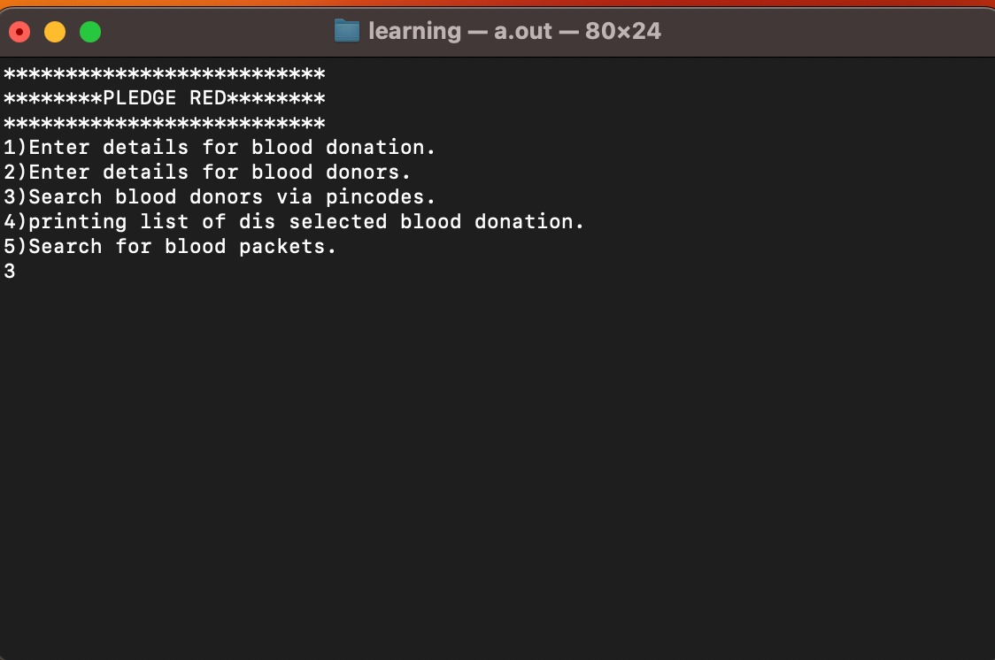
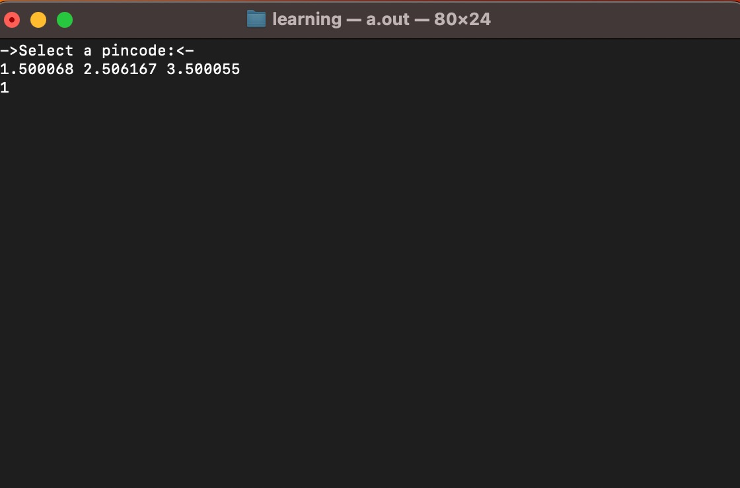
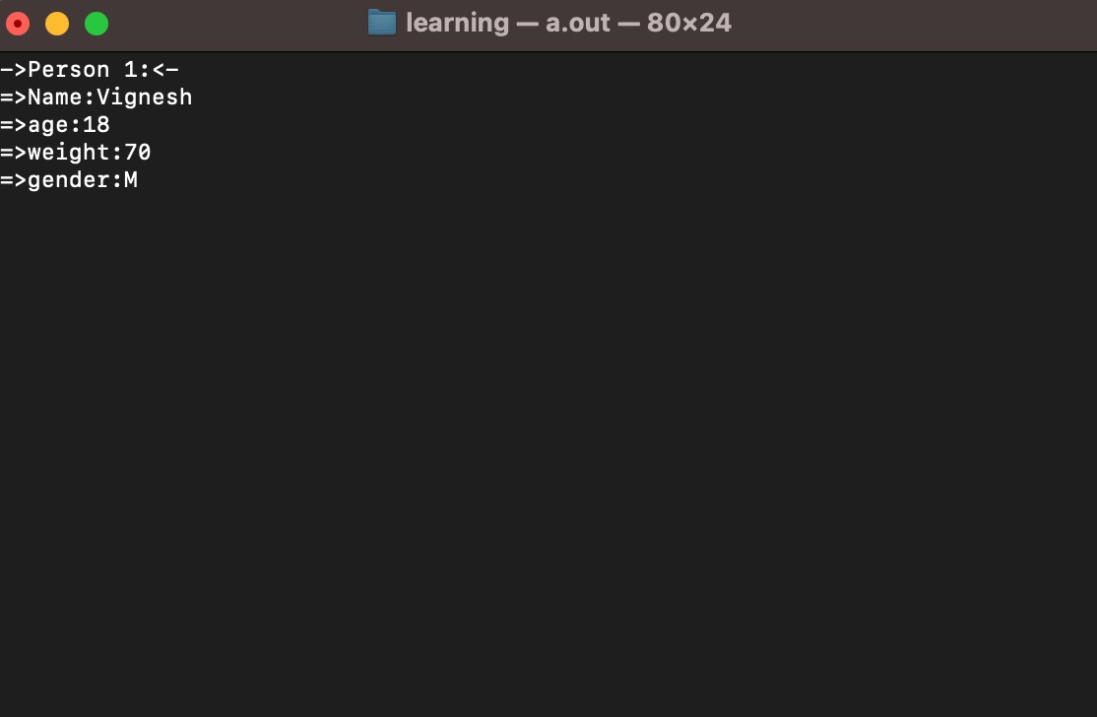
Out put

Slide 7
